Slide 1

KSI Dataset
Group 2
Ngan, Tsang Kwong
Pillai, Rani Krishna
Ramos, Kirstin Megga
Wong, Yu Kwan
ZHANG, AILIN

Slide 2
Killed or Seriously Injured dataset
This data only includes events where a person sustained a major or fatal injury in a traffic collision event.
Dataset classifies the severity of injury:
Major Injury: A non-fatal injury that is severe enough to require the injured person to be admitted to hospital, even if only for observation at the time of the collision.
Fatal: Fatal injury (person sustains bodily injuries resulting in death) only those cases where death occurs in less than 366 days as result of the collision.

Slide 3
Purpose of this project:
Pre-processing - Retrieve & prepare the data:
Model building & fine tuning
Model deployment
In the end, we could develop a predictive machine learning model (classifier) and deploy it as a web API for inference.

Slide 4
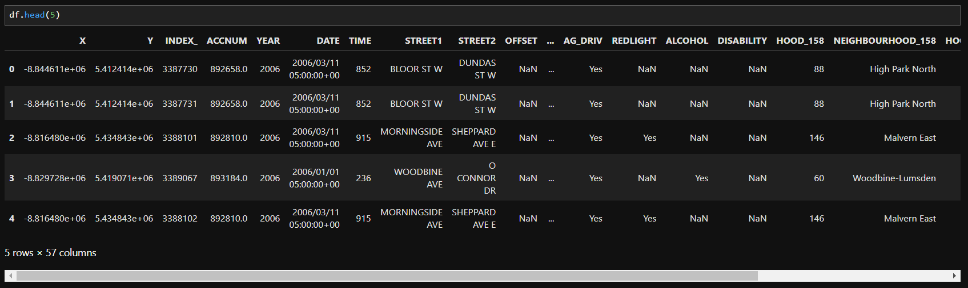

Slide 5
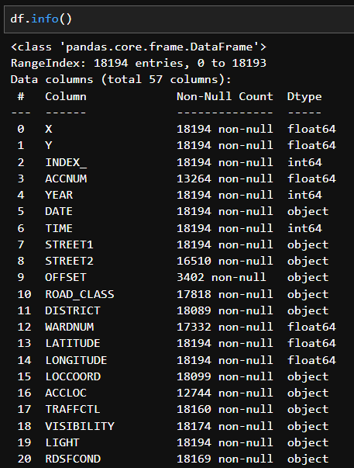
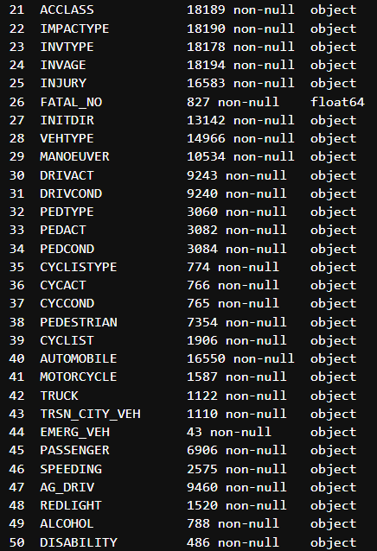
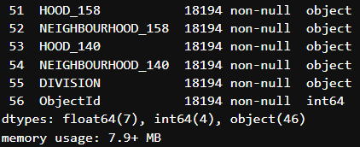

Slide 6
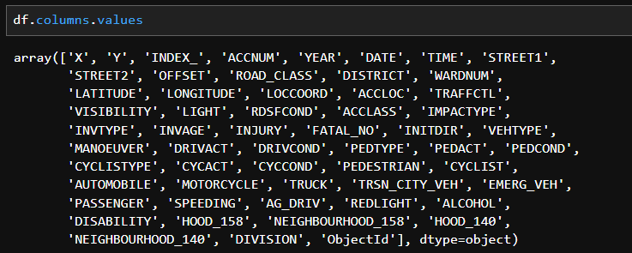

Slide 7
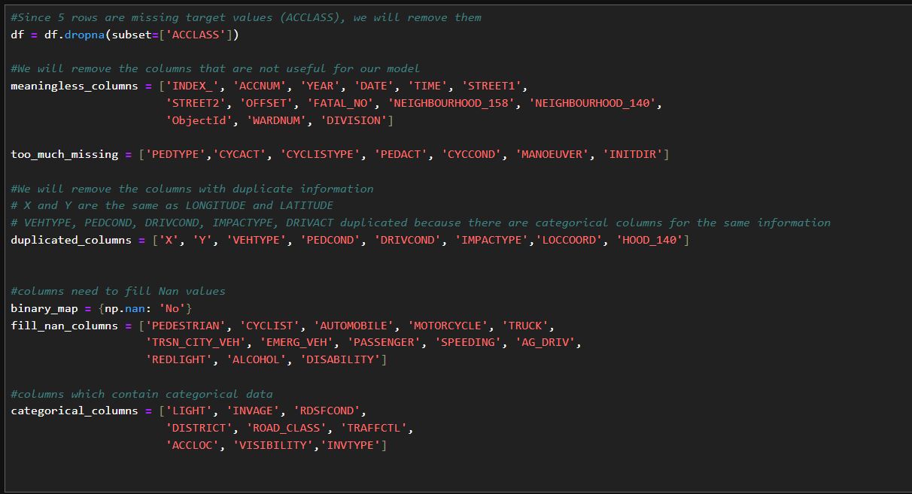
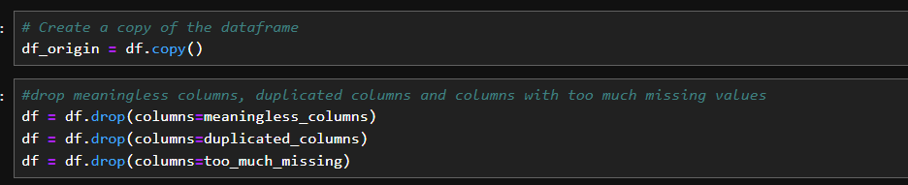

Slide 8
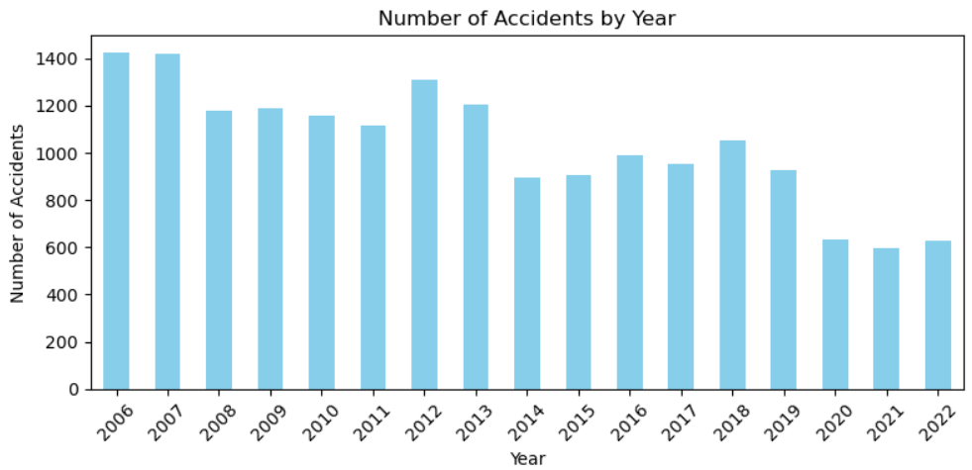
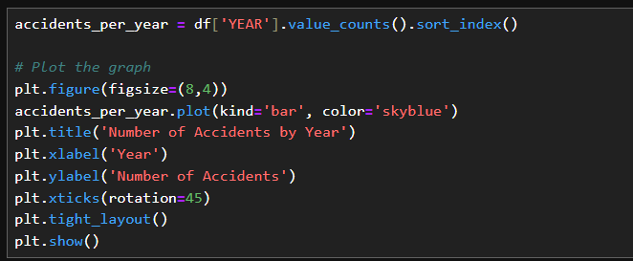

Slide 9
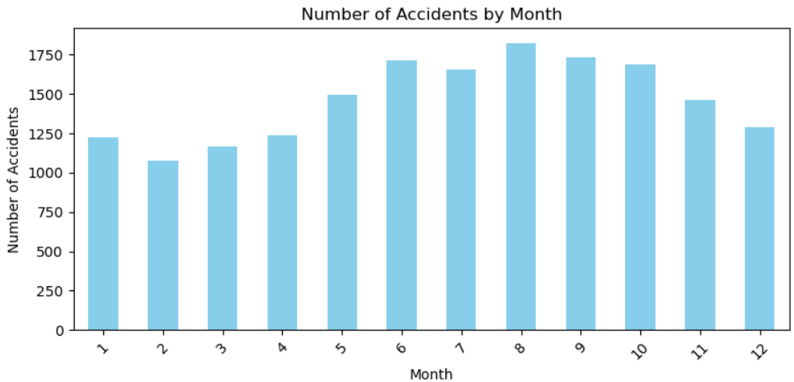
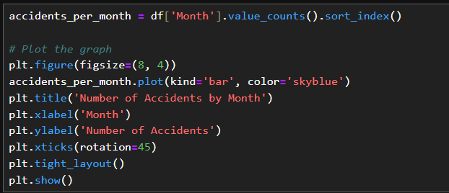

Slide 10
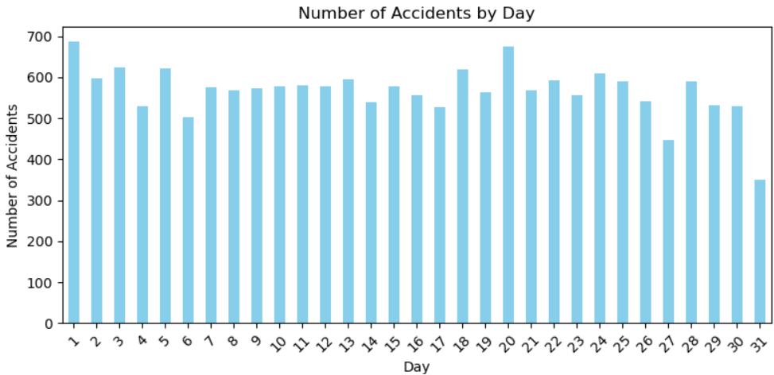
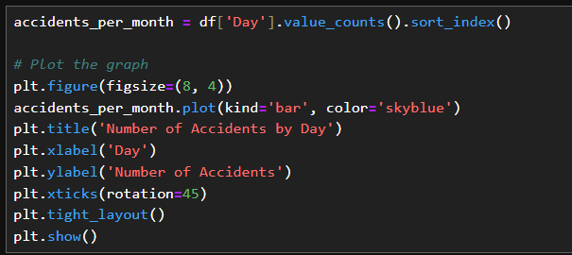

Slide 11
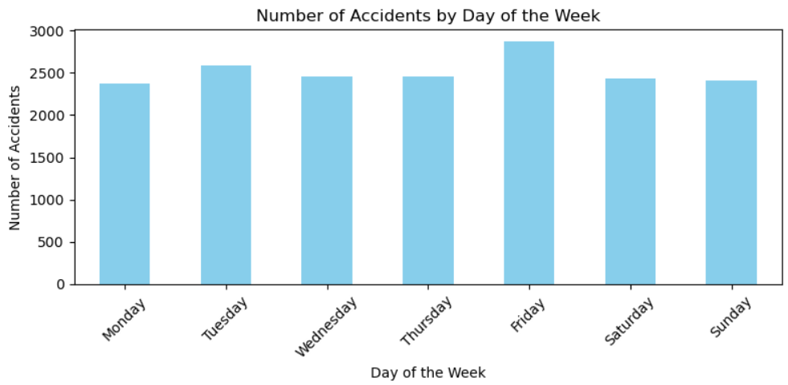
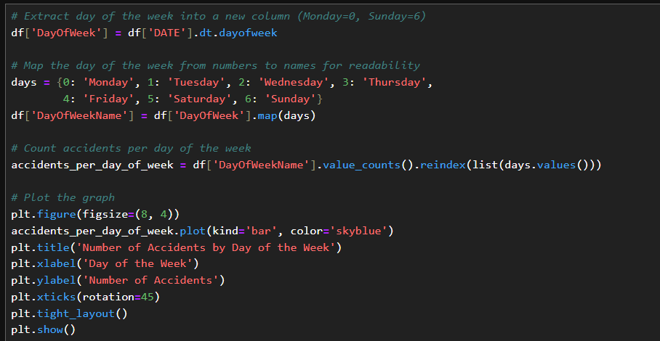

Slide 12
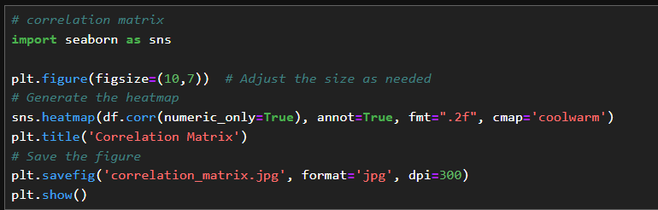
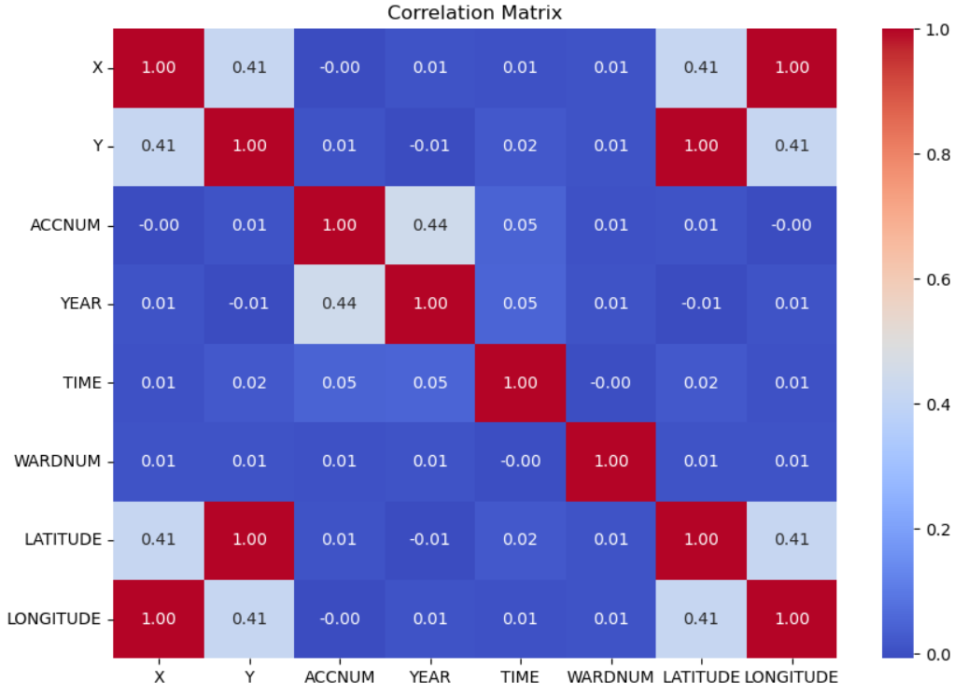

Slide 13
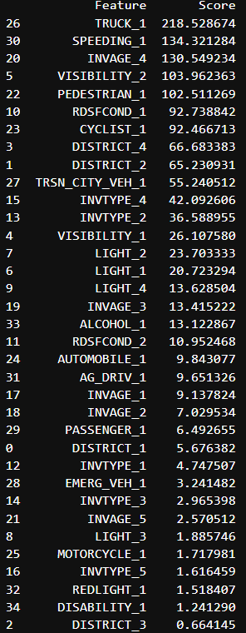
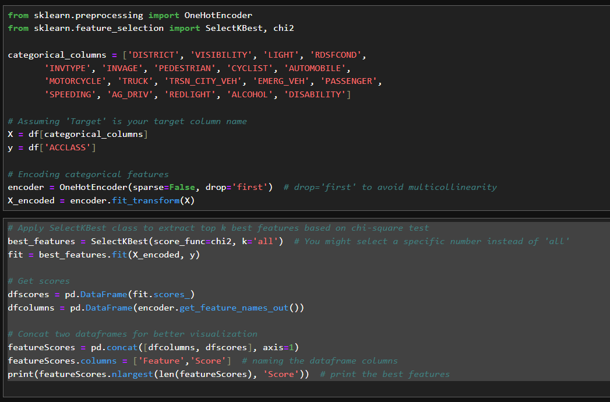

Slide 14
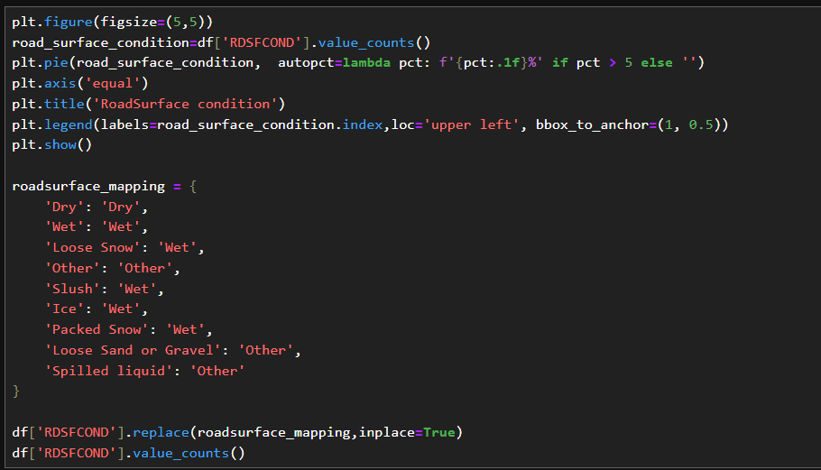
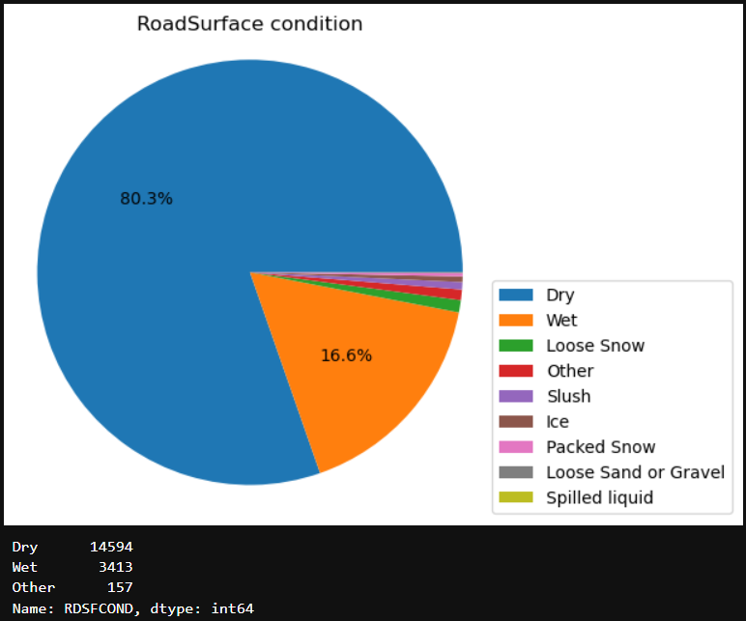

Slide 15
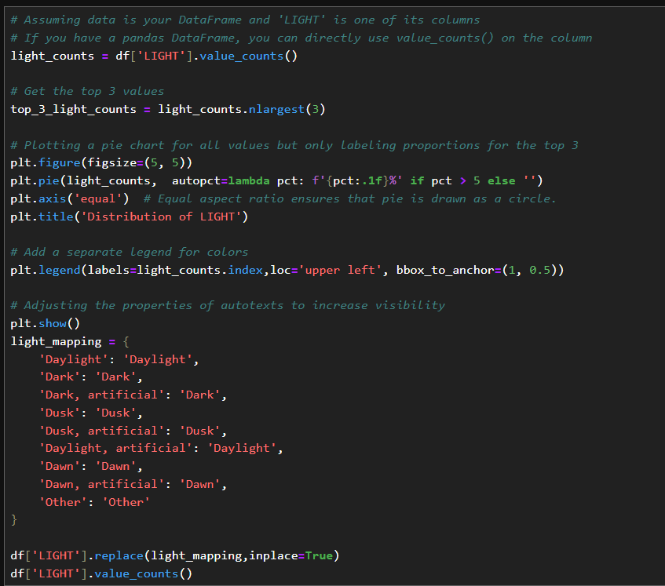
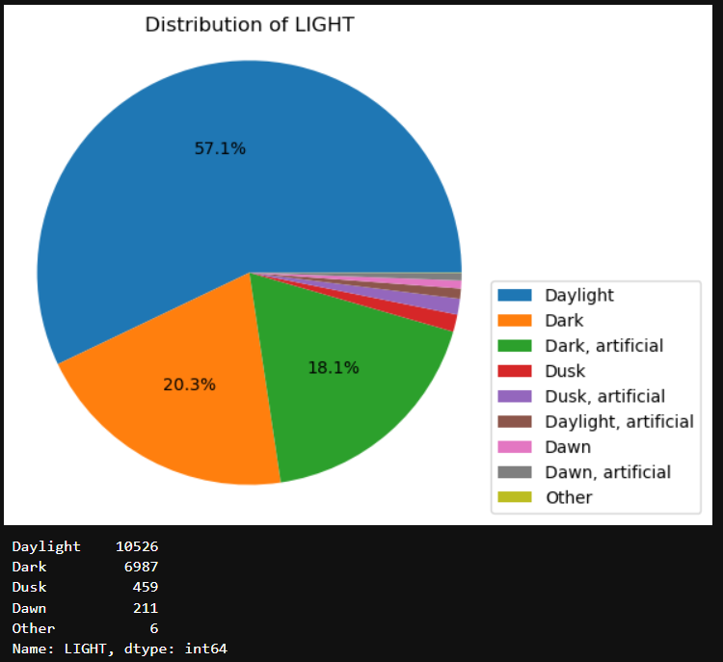

Slide 16
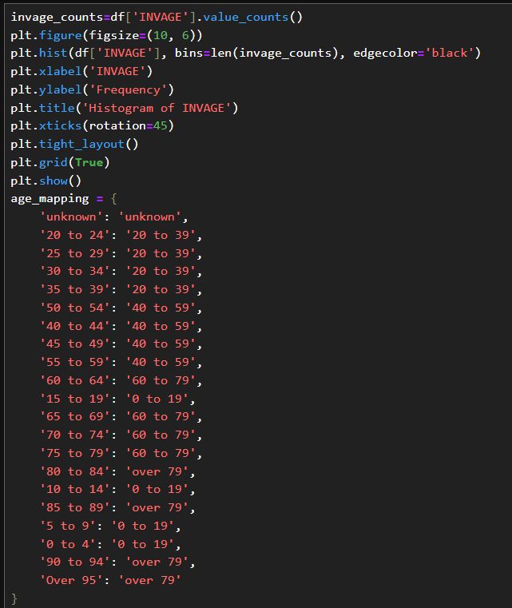
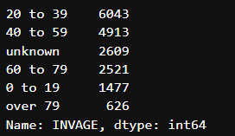
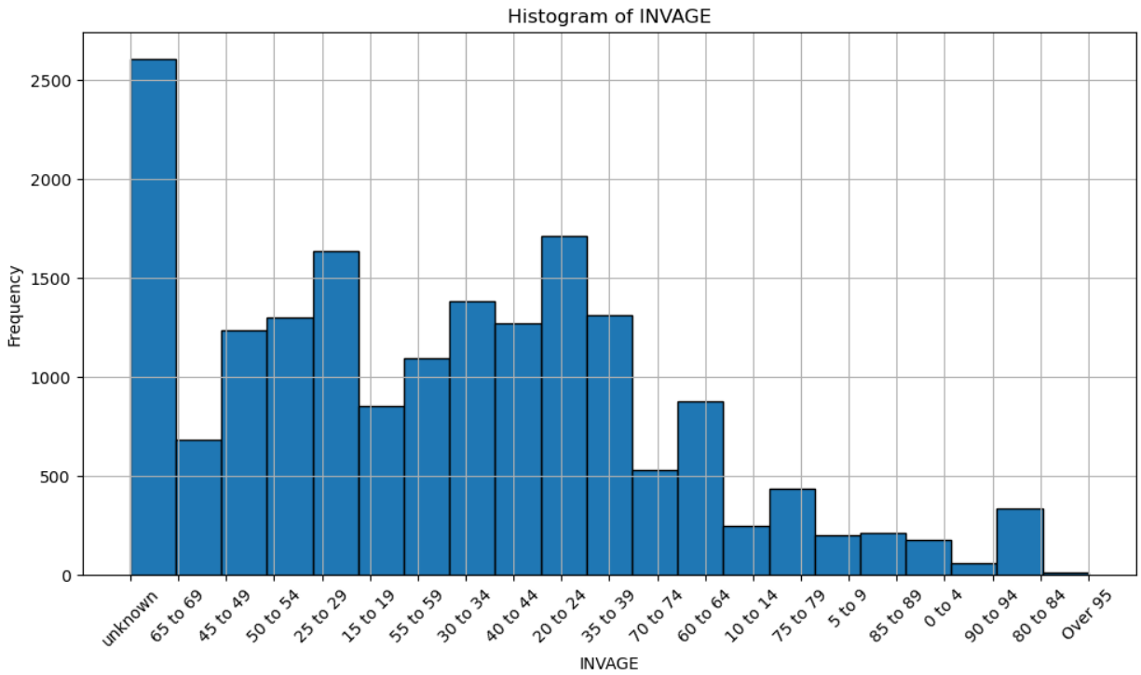


Slide 17
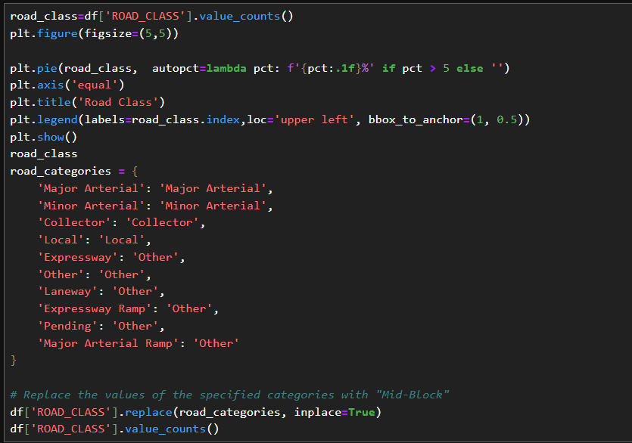
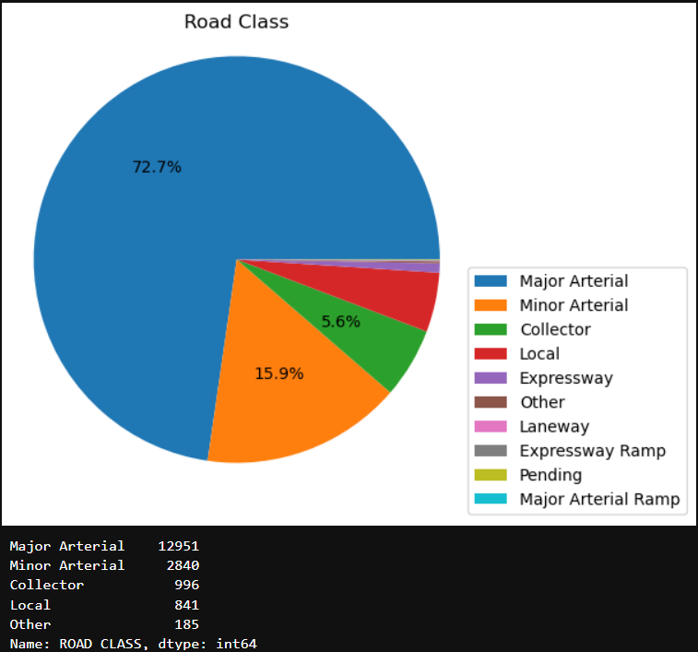

Slide 18
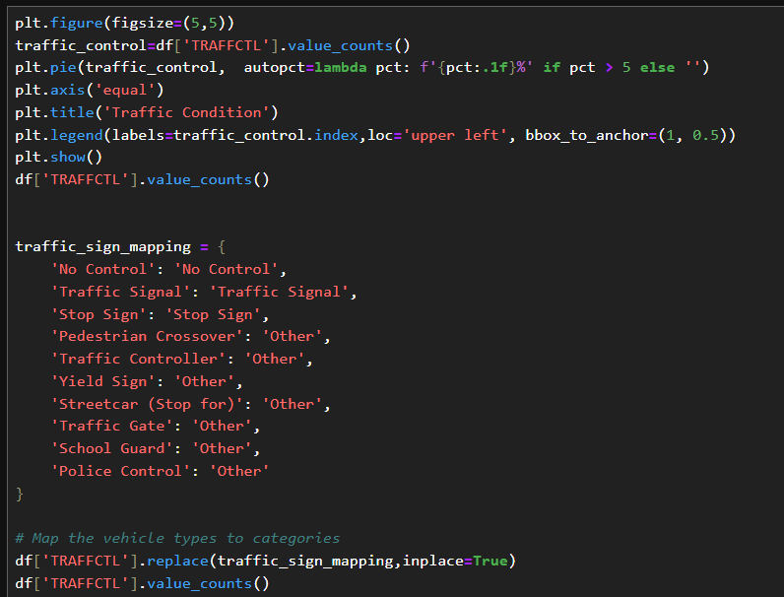
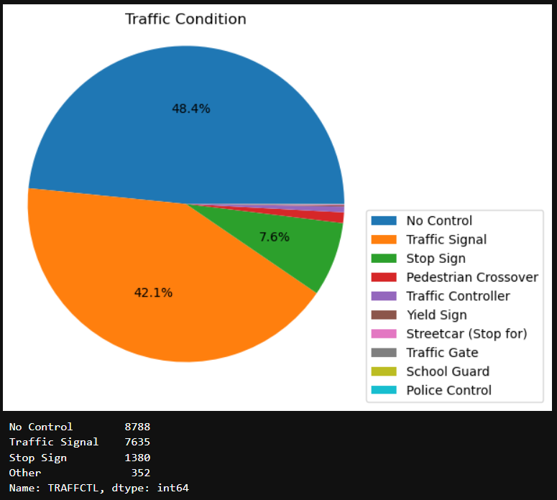

Slide 19
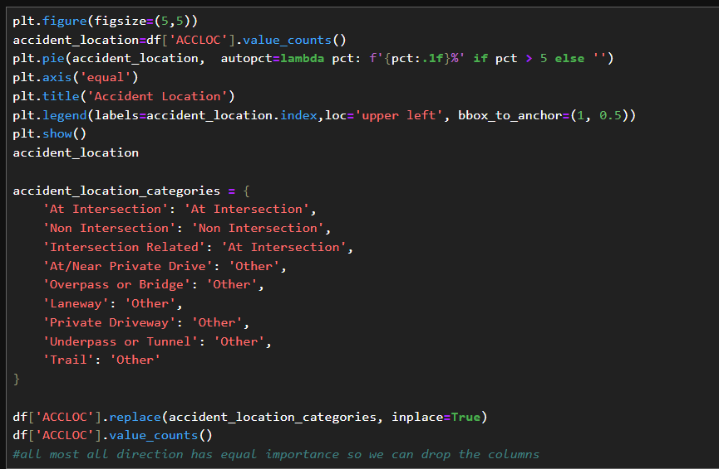
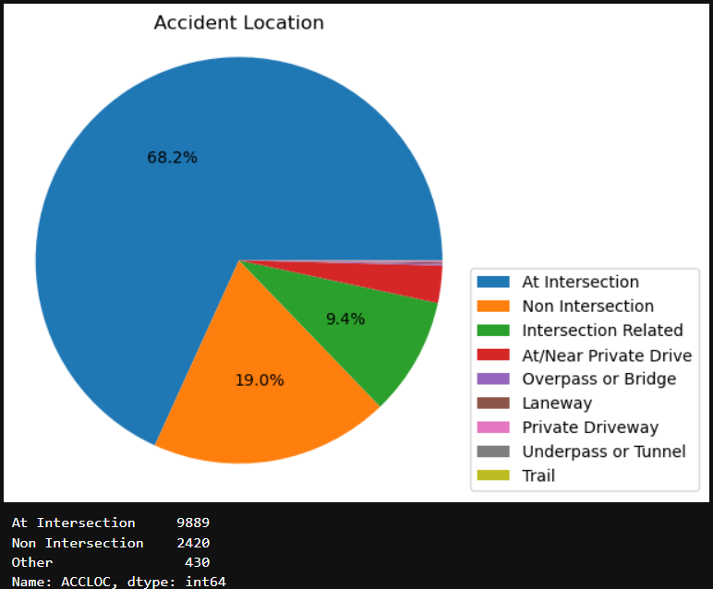

Slide 20
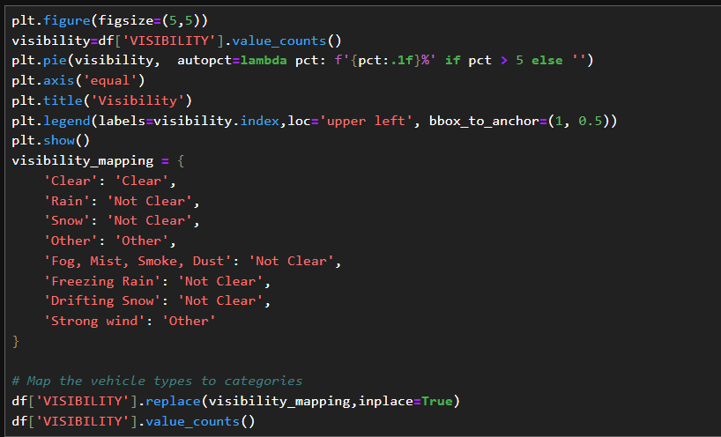
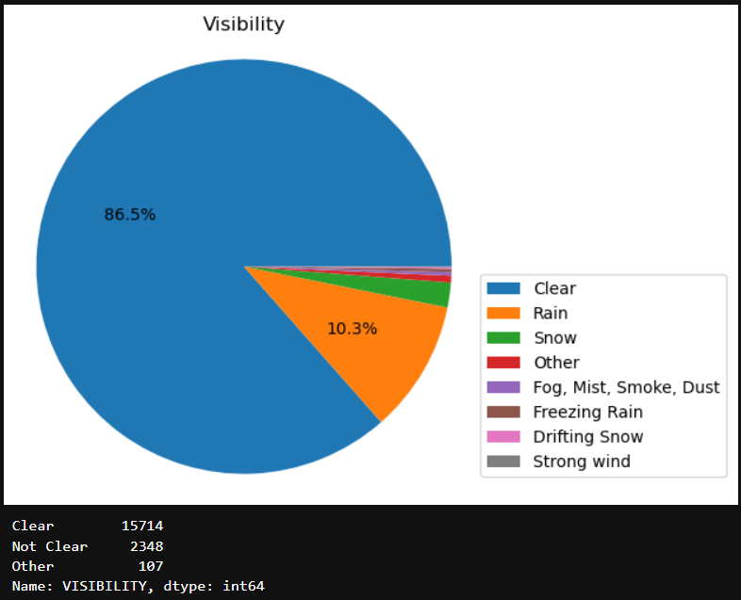

Slide 21
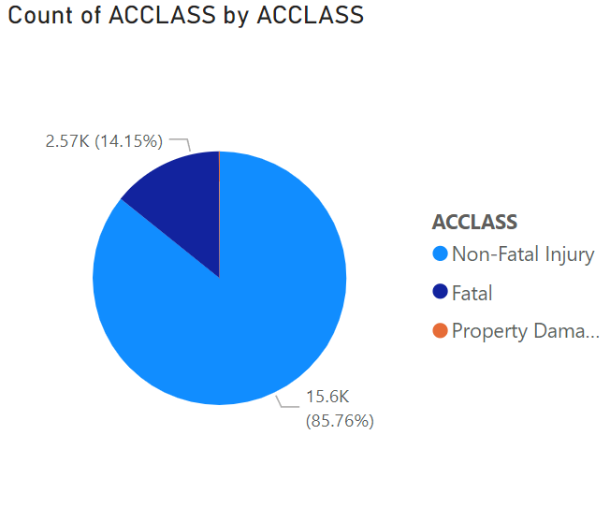
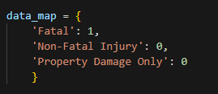
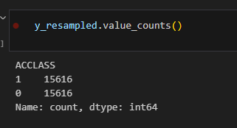

Slide 22
Agenda: Project phase #2
Predictive model building
Model scoring and evaluation
Deploying the model
Key findings
Conclusion

Slide 23
Predictive model building
Model building
Naive Bayes
Logistic regression
SVM
Voting classifier
Random forest
Fine tuning: using Grid search and randomized grid search

Slide 24
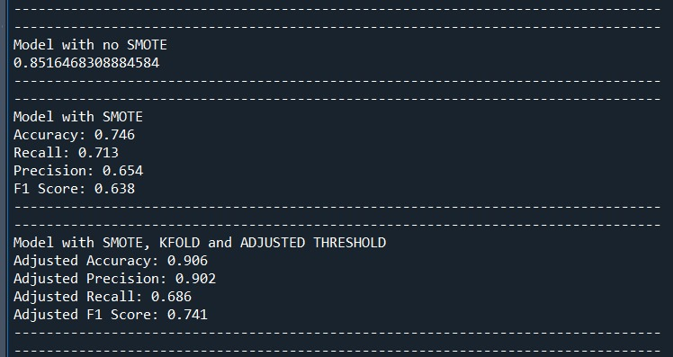
Model building: Naive Bayes
The model with SMOTE, K-Fold, and Adjusted Threshold appears to be the best overall, providing a robust balance of accuracy, precision, and F1 Score.

Slide 25
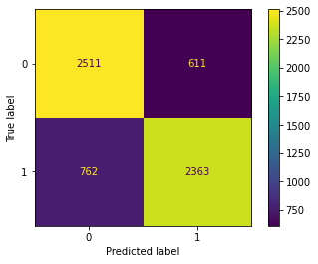
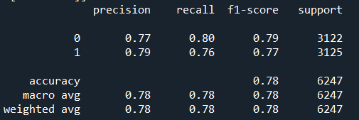
Model building: Logistic regression
The initial logistic regression
model = LogisticRegression(solver='lbfgs', max_iter=1000)

Slide 26
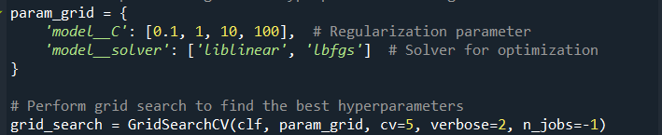
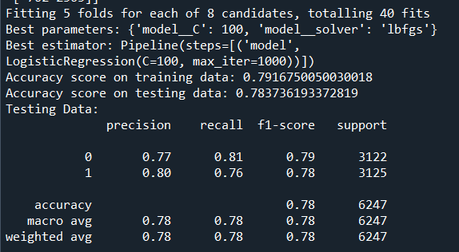
Model building: Logistic regression
Fine tuning
by using Grid Search

Slide 27
Model building: SVM
SVM classifier using four distinct kernels: linear, rbf, poly, and sigmoid.
Kernel | Linear | rbf | poly | sigmoid
Accuracy on training set | 0.787 | 0.917 | 0.911 | 0.662
Accuracy on testing set | 0.776 | 0.905 | 0.898 | 0.652

Slide 28
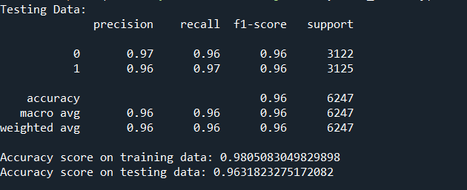
Model building: SVM
2. Fine tuning: using Grid search
Best parameters = {'classifier__C': 10, 'classifier__gamma': 1.0, 'classifier__kernel': 'rbf'},

Slide 29
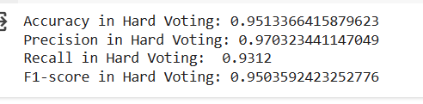
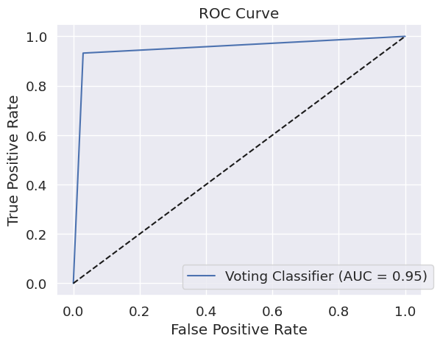
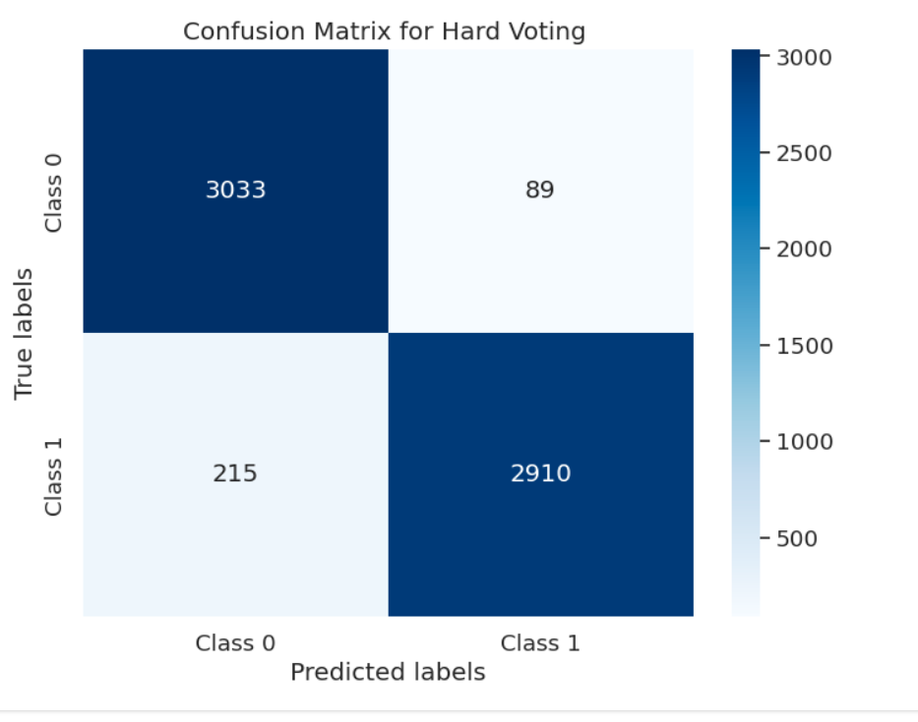
Model building: Voting classifier
Hard voting

Slide 30
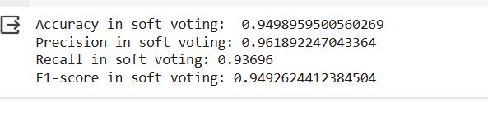
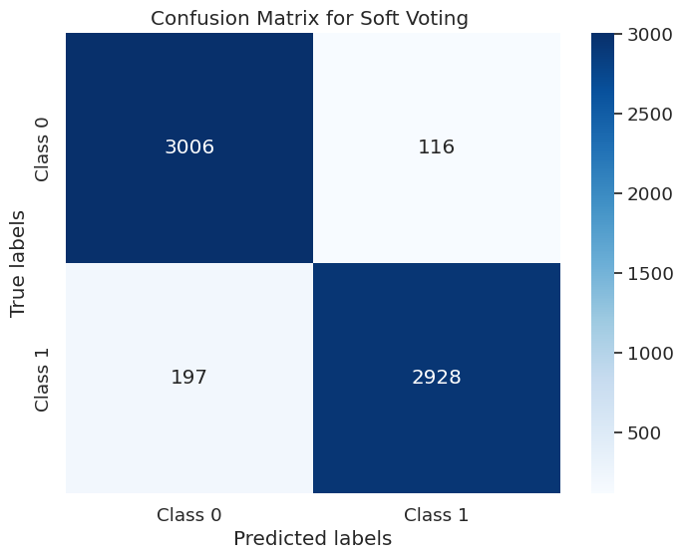
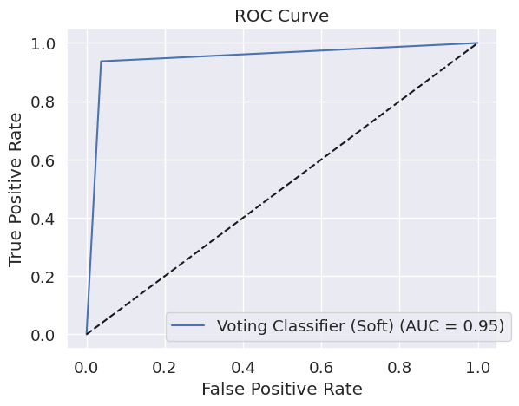
Model building: Voting classifier
2. Soft voting

Slide 31
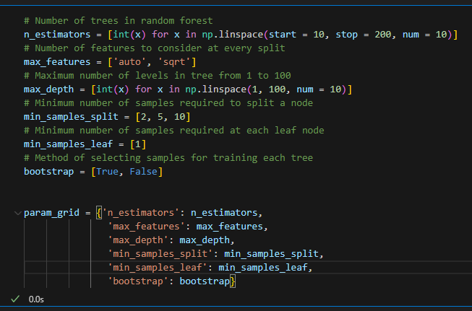


Model building: Random forest
Attempt 1: min_sample_leaf = 1

Slide 32


Model building: Random forest
Attempt 1: min_sample_leaf = 1

Slide 33



Model building: Random forest
2. Attempt 2: min_sample_leaf is at least 2

Slide 34


Model building: Random forest
2. Attempt 2: min_sample_leaf is at least 2

Slide 35



Model building: Random forest
3. Attempt3: minimize max depth to 20

Slide 36

Model building: Random forest
3. Attempt 3: minimize max depth to 20

Slide 37



Model building: Random forest
4. Attempt4: max_depth is set to 4, 6, 8,10.

Slide 38


Model building: Random forest
4. Attempt4: max_depth is set to 4, 6, 8,10.

Slide 39
Model scoring and evaluation
The socre from tuning model for each algorithm
Algorithm | Naive Bayes | Logistic Regression | SVM | Voting Classifier (hard voting) | Random Forest (1st attempt)
Accuracy | 0.906 | 0.784 | 0.963 | 0.951 | 0.955
Precision | 0.902 | 0.780 | 0.960 | 0.970 | 0.960
Recall | 0.686 | 0.780 | 0.960 | 0.931 | 0.960
F1 Score | 0.741 | 0.780 | 0.960 | 0.950 | 0.950

Slide 40

Deploying the model
API

Slide 41
Key findings
Naive Bayes:
Shows a high accuracy score of 0.906, but lower precision, recall, and F1 score
Indicating that it may be classifying some instances incorrectly.
Logistic Regression:
Has a lower accuracy score compared to Naive Bayes but shows similar precision, recall, and F1 score.
SVM:
Demonstrates the highest accuracy score of 0.963, along with high precision, recall, and F1 score, indicating its effectiveness in classification tasks.

Slide 42
Key findings
Voting Classifier (hard voting):
Achieves a high accuracy score of 0.951, with excellent precision, recall, and F1 score
It combines the strengths of multiple classifiers effectively
Random Forest (1st attempt):
Shows a competitive accuracy score of 0.955, with high precision, recall, and F1 score
Showing it a strong contender for classification tasks.
SVM and the Voting Classifier (hard voting) are more suitable for this issue in terms of accuracy and overall performance across precision, recall, and F1 score.
Random Forest also performs well but slightly lower than SVM and the Voting Classifier. Naive Bayes and Logistic Regression show lower accuracy and performance metrics compared to the other algorithms.

Slide 43
Conclusion
This project exemplifies the power of predictive analytics in enhancing road safety and mitigating fatalities.
We were able to explore, model, and fine-tune predictive models using machine learning algorithms and classifiers.
Using Machine learning and API technology, we have developed a robust predictive software capable of assessing the likelihood of fatal collisions based on various factors.

